Slide 1

Exercise 3: Model Training & Evaluation

Slide 2



Outline
1
Motivation – contextualizing model training & evaluation within project workflow
Scikit-Learn
https://commons.wikimedia.org/w/index.php?curid=71445288
2
Methods shown in the lab today (more in the lab sheet)
SVM
Decision Trees
K-Fold Cross Validation
Deep Learning models (TensorFlow & PyTorch)
TensorFlow
https://commons.wikimedia.org/w/index.php?curid=113524128
PyTorch
https://commons.wikimedia.org/w/index.php?curid=88256697

Slide 3
Motivation
Project Workflow
Jupyter Notebooks – Today’s Lab
Choose broad ML field (visual, audio, motion, etc.)
Choose dataset
Objective from labels – i.e., classification, regression
Loss function(s)
Choose target board(s)
TensorFlow or PyTorch
Design ML model
Performance/cost tradeoffs (efficiency vs. accuracy/precision)
Design training loop
Model generalization: early stopping, dropout, regularization, etc.
Quantization
Port network to board(s)
Design inference & evaluation functions
Report model performance & costs
Evaluation metrics vs number of parameters, layers, MACs, etc.
.ipynb files
Look at how to:
load datasets
implement classical ML & DL models
fit/train them
display evaluation metrics (without porting to edge devices for now).

Slide 4
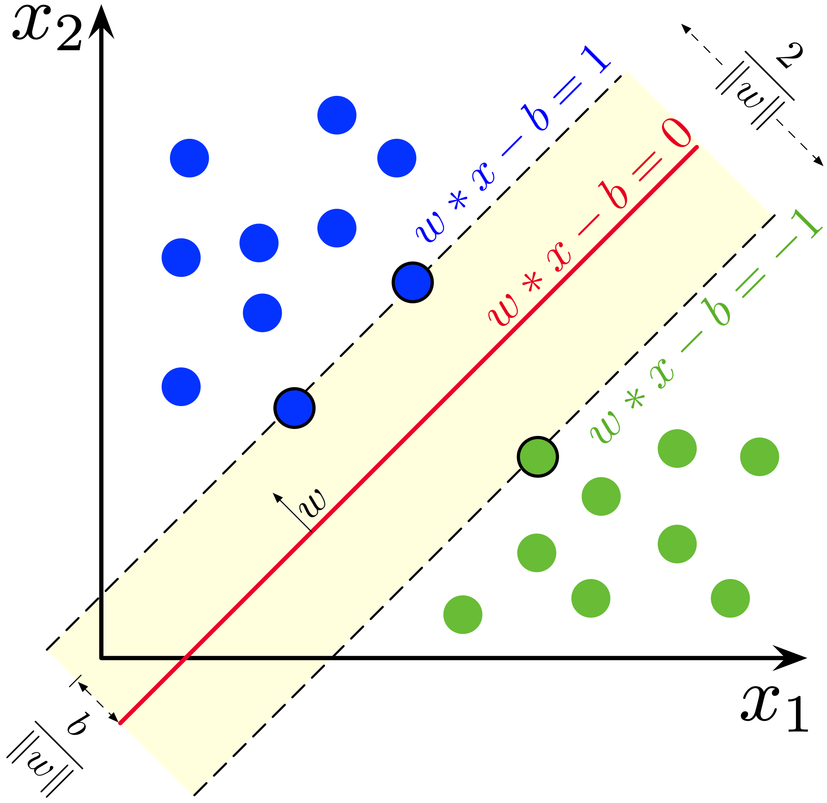
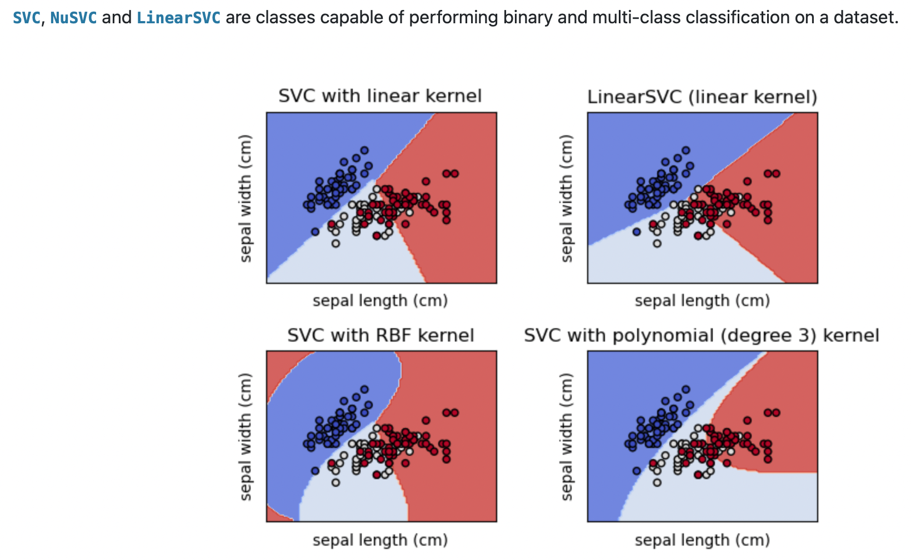
Estimators for Classification – SVMs with Scikit-Learn
scikit-learn: ML library for classification, regression and clustering.
e.g., SVMs, random forests, gradient boosting, K-Means, etc.
SVM with scikit-learn: https://scikit-learn.org/stable/modules/svm.html
Follows the .fit() and .predict() supervised algorithm flow.
SVMs – Notebook 1 & 2
https://commons.wikimedia.org/w/index.php?curid=73710028
Scikit-Learn illustrations of SVC algorithms
https://scikit-learn.org/stable/modules/svm.html

Slide 5
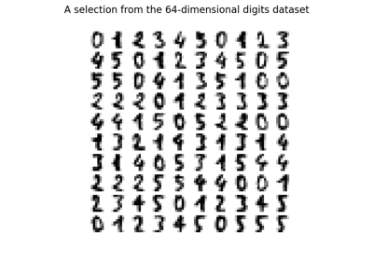
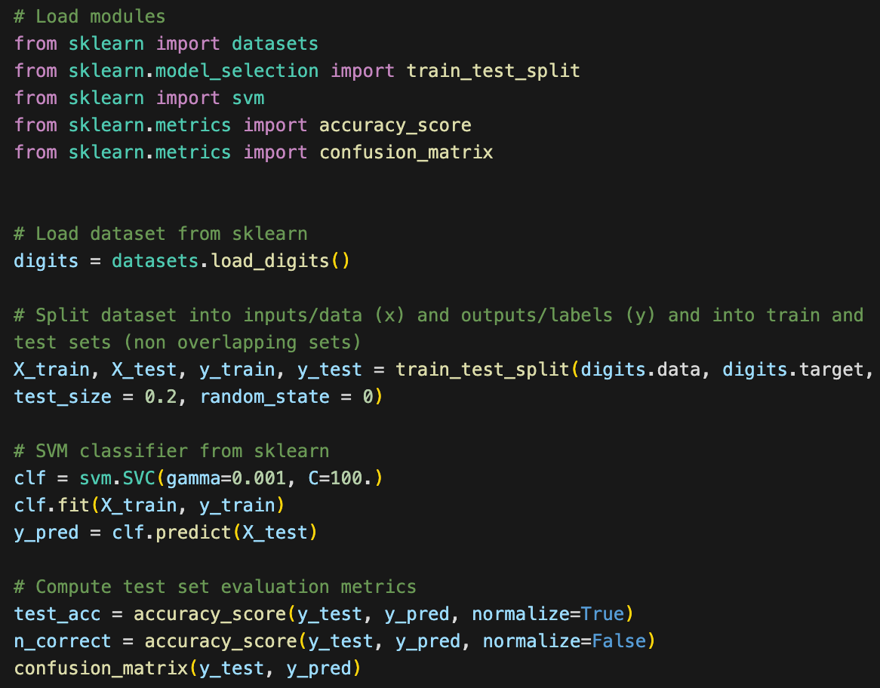
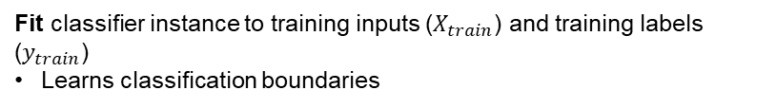
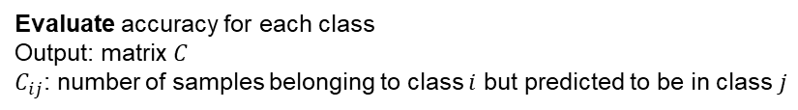
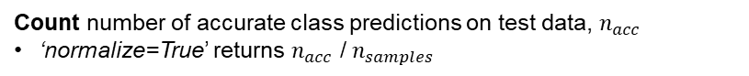
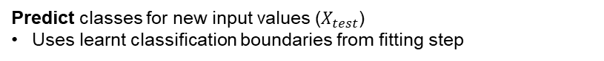
SVMs with Scikit-Learn – Code Example
1
Load inputs (images) and outputs (classification labels)
Split into inputs, outputs, test and train sets
2
Initialize classifier instance w/ params:
ɣ: RBF kernel coefficient
C: regularizer
3
Fit classifier instance to training inputs ($X_{train}$) and training labels ($y_{train}$)
Learns classification boundaries
1
4
Predict classes for new input values ($X_{test}$)
Uses learnt classification boundaries from fitting step
2
5
Count number of accurate class predictions on test data, $n_{acc}$
‘normalize=True’ returns $n_{acc}$ /$n_{samples}$
3
4
6
Evaluate accuracy for each class
Output: matrix $C$
$C_{ij}$: number of samples belonging to class $i$ but predicted to be in class$j$
5
6

Slide 6
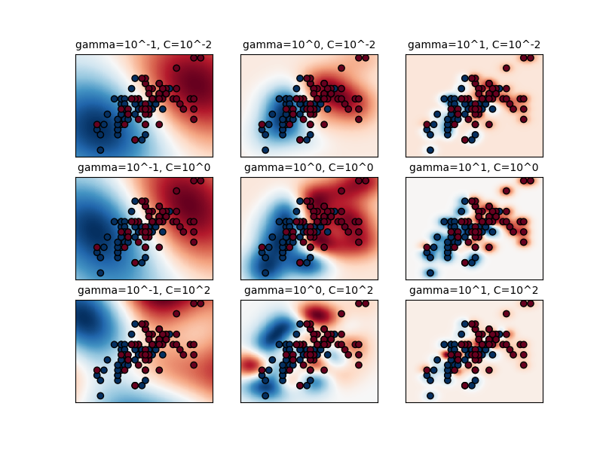
SVMs with Scikit-Learn – Varying Hyperparameters
Increasing ɣ
Hyperparameter Tuning
Smoother decision boundaries obtained with lower ɣ
Lower C encourages larger margin at the cost of accuracy
Finding optimal values of hyperparameters can be difficult
Can use techniques like K-Fold Cross Validation or Grid Search
both seen in the lab today
Increasing C
Scikit-Learn visualization of parameter effects for RBF SVM
https://scikit-learn.org/stable/auto_examples/svm/plot_rbf_parameters.html

Slide 7
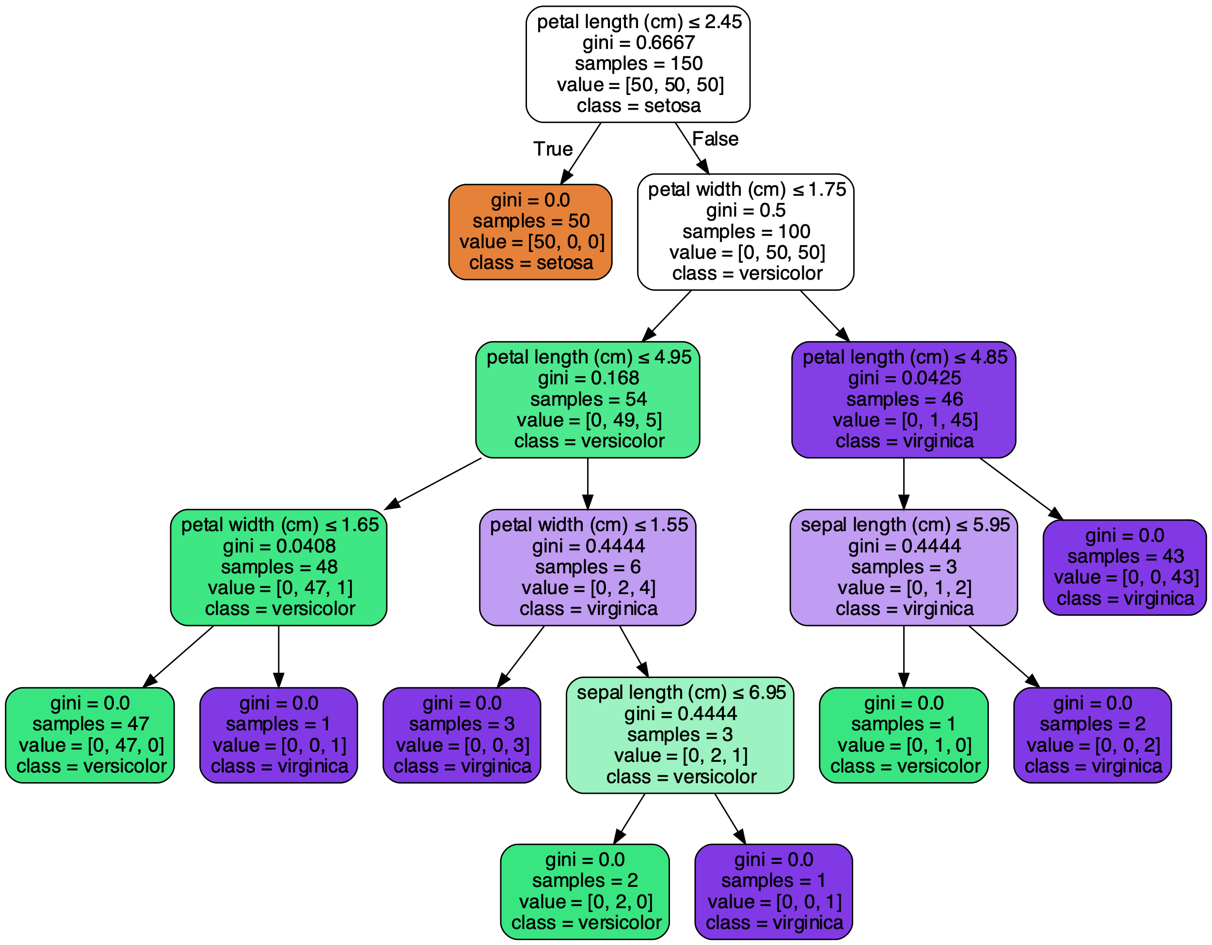
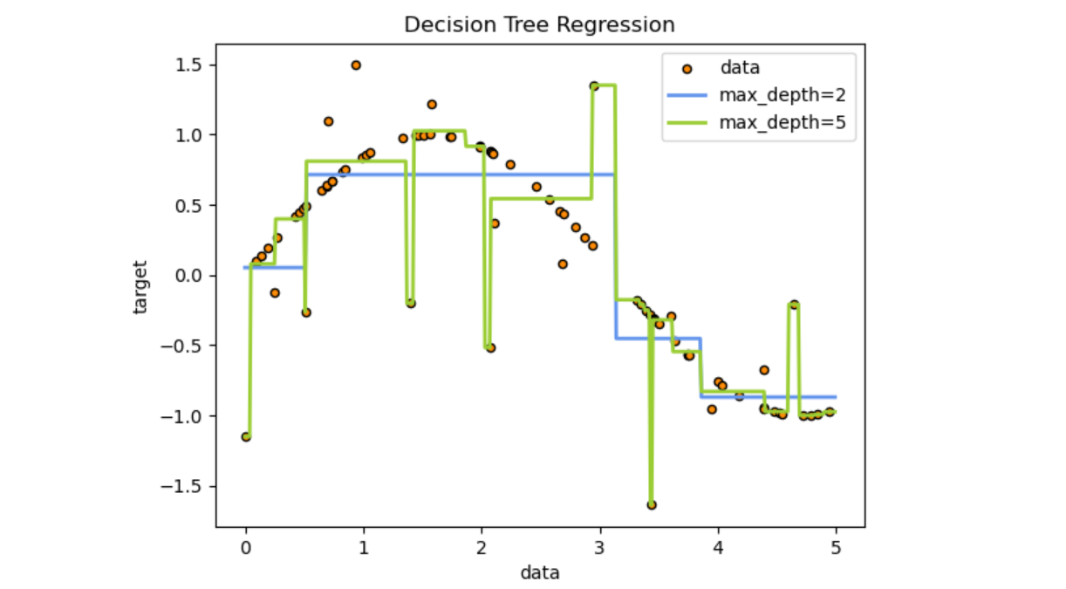
Estimators for Classification – Decision Trees with scikit-learn
Decision trees with scikit-learn: https://scikit-learn.org/stable/modules/tree.html
.fit() and .predict() supervised algorithm flow.
Plot tree after fitting: .plot_tree() → ‘white-box model’
Scikit-Learn Decision Trees
https://scikit-learn.org/stable/modules/tree.html
Scikit-Learn plot_tree()
https://scikit-learn.org/stable/auto_examples/tree/plot_iris_dtc.html

Slide 8
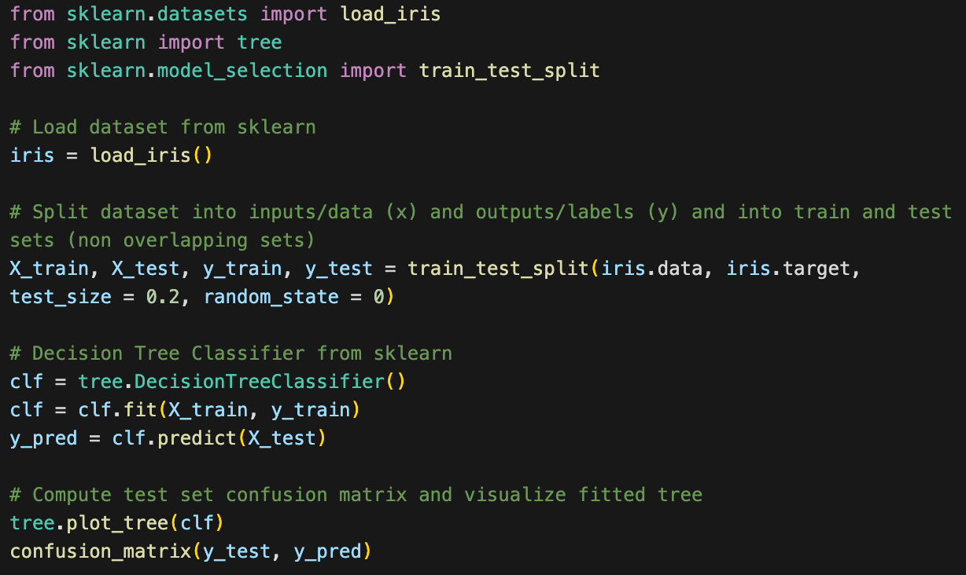
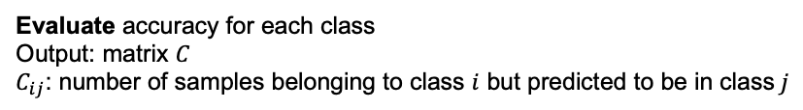
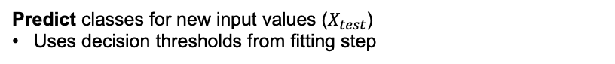
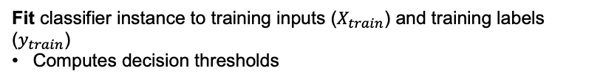
Decision Trees with Scikit-Learn – Code Example
1
Load inputs (plant features) and outputs (classification labels)
Split into inputs, outputs, test and train sets
2
Initialize decision tree classifier instance
3
Fit classifier instance to training inputs ($X_{train}$) and training labels ($y_{train}$)
Computes decision thresholds
1
4
Predict classes for new input values ($X_{test}$)
Uses decision thresholds from fitting step
2
5
Plot decision tree
Model is explainable → know which inputs lead to what predictions
3
4
6
Evaluate accuracy for each class
Output: matrix $C$
$C_{ij}$: number of samples belonging to class $i$ but predicted to be in class$j$
5
6

Slide 9
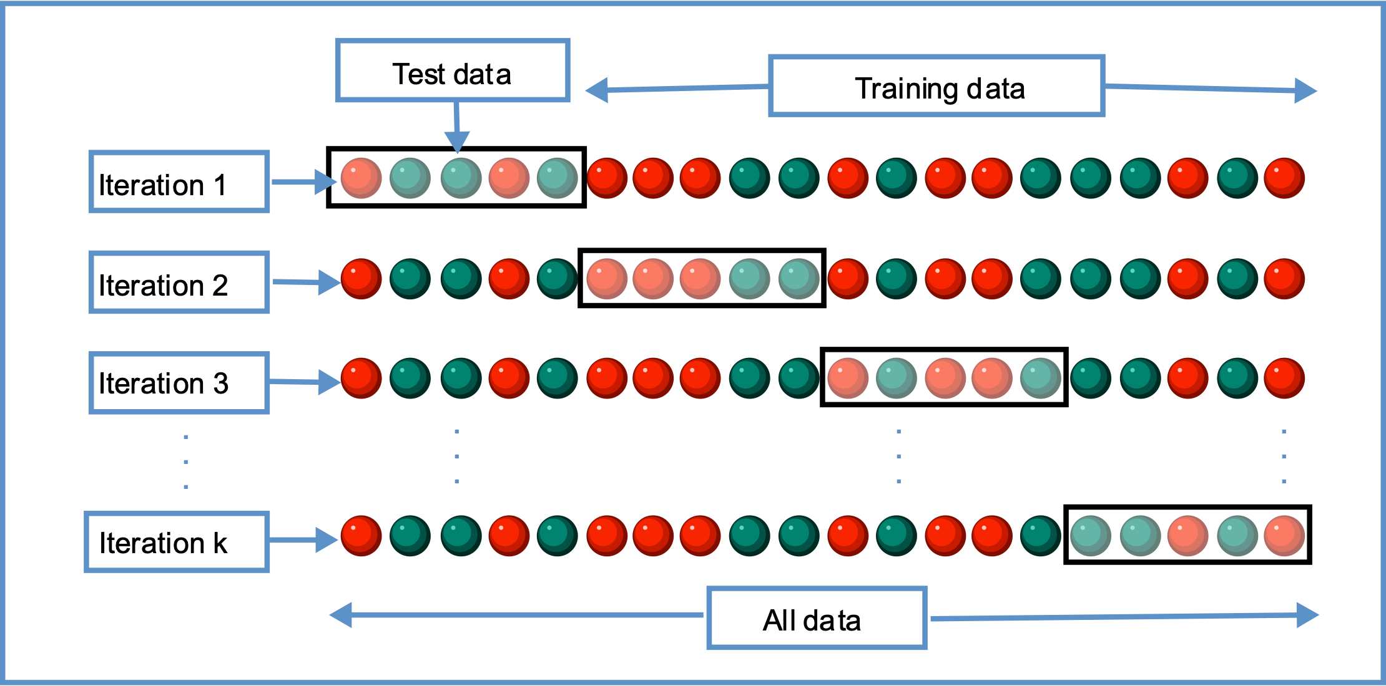
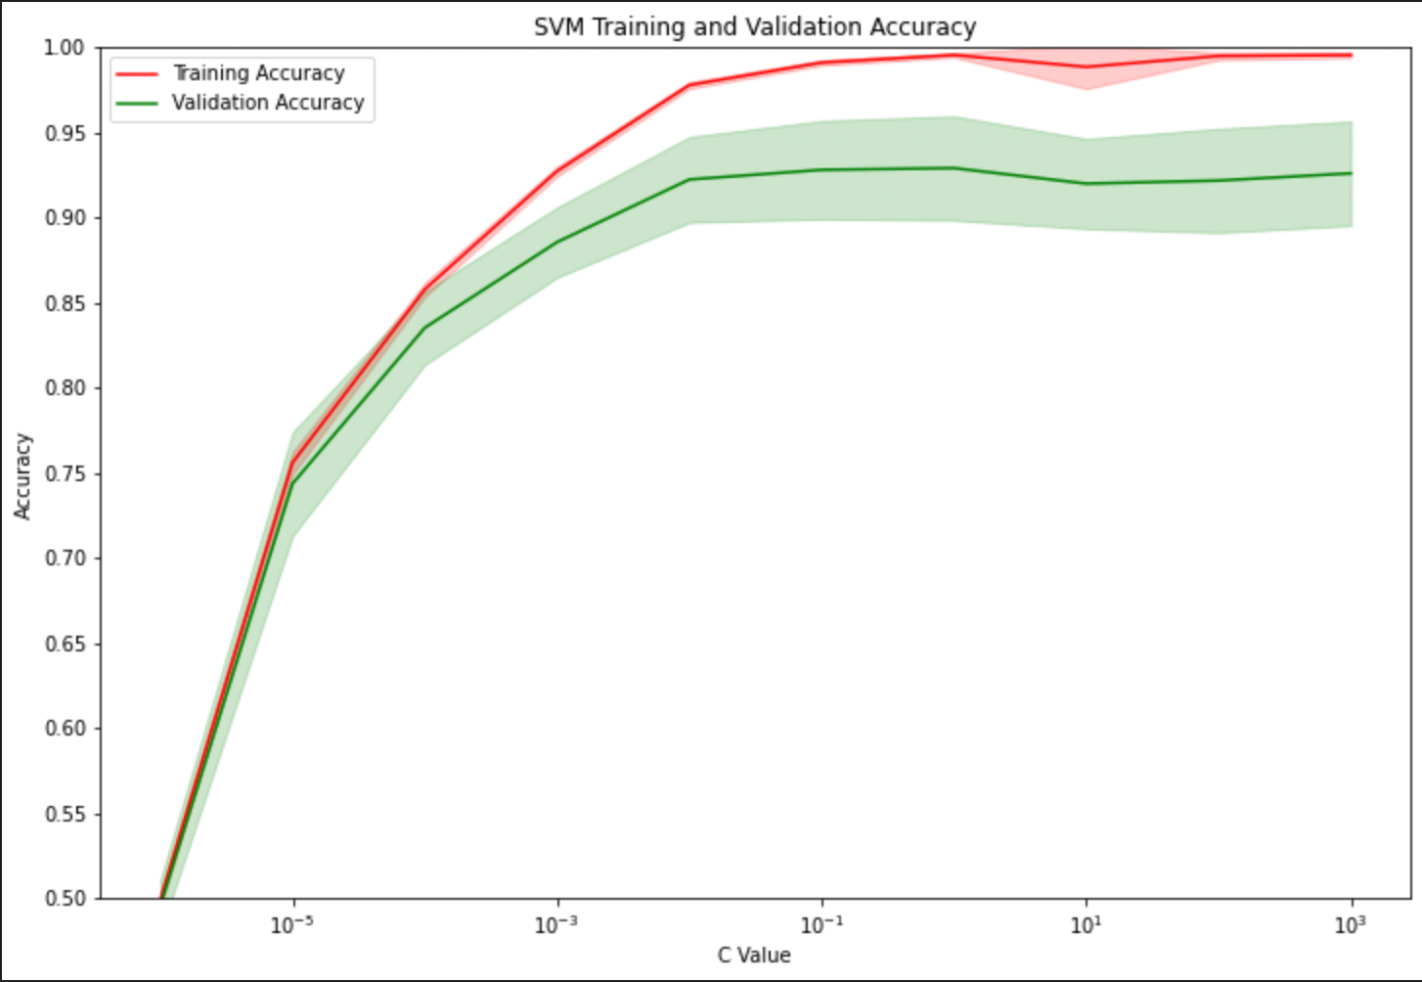
Model Selection – K-Fold Cross Validation with scikit-learn
Validation Curve with scikit-learn: https://scikit-learn.org/stable/modules/generated/sklearn.model_selection.validation_curve.html
Get test & training scores by varying values of a certain hyperparameter.
Set ‘cv = k’ where k = number of folds for cross validation.
Plot scores for every hyperparameter of interest, e.g., in today’s lab:
Regularization parameter ‘c’
Feature selection (‘SelectKBest’, scikit-learn)
K-Fold Cross Validation
https://commons.wikimedia.org/w/index.php?curid=82298768
Scikit-Learn plotting validation_curve values for varying ‘c’ parameter (regularization – L2)
Lab 3 Notebook 2

Slide 10
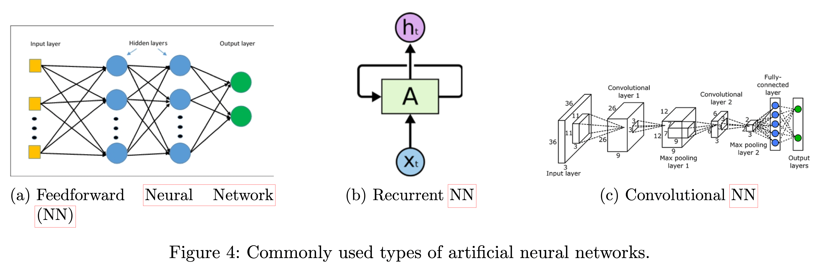
Deep Learning Models
TensorFlow quick start for beginners: https://www.tensorflow.org/tutorials/quickstart/beginner
PyTorch quick start: https://pytorch.org/tutorials/beginner/basics/quickstart_tutorial.html

Slide 11
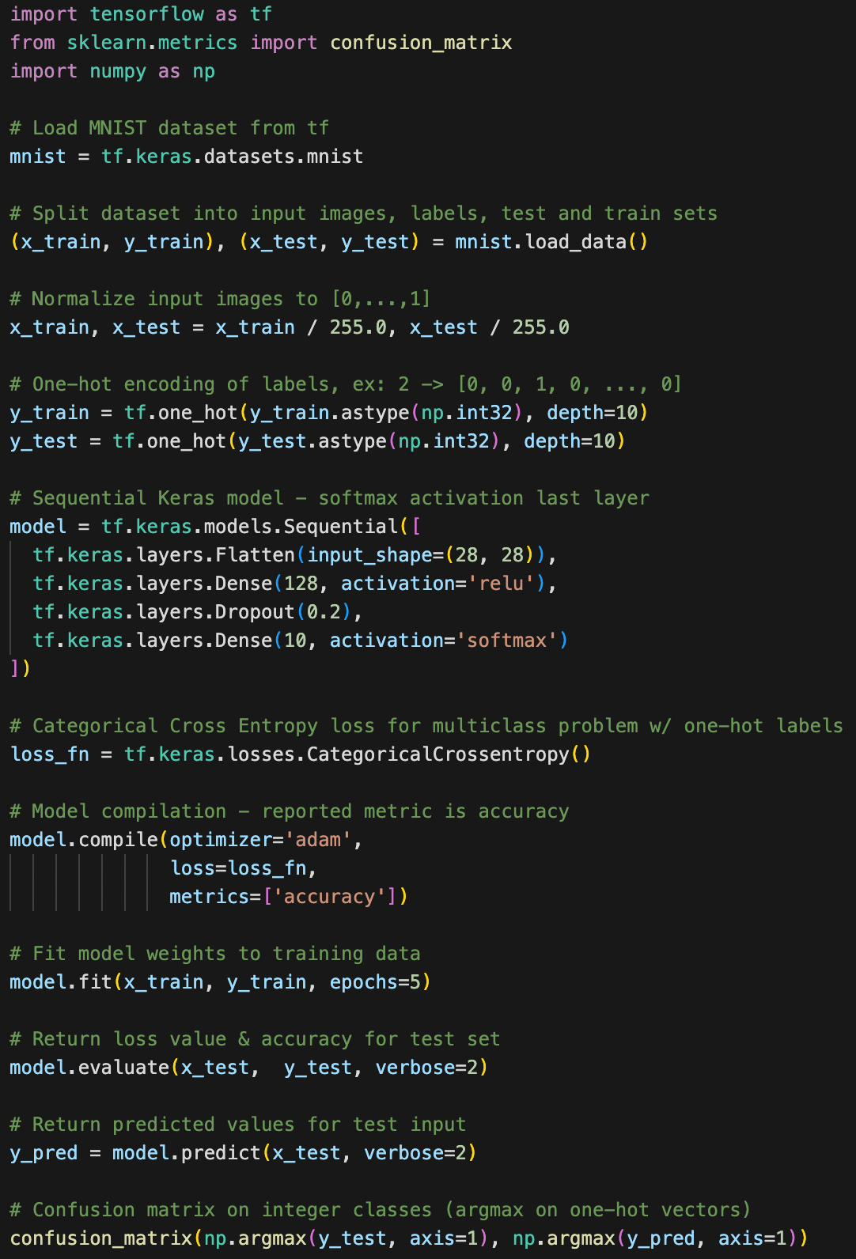
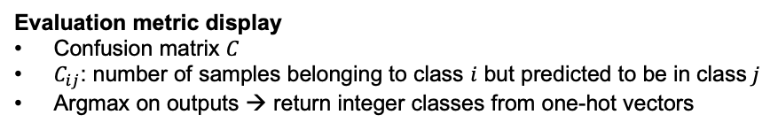
Deep Learning Models – TensorFlow Code Example
1
Load inputs (images) & outputs (classification labels)
Split into inputs, outputs, test and train sets
1
2
Pre-process data
Normalize grayscale image → from [0, .., 255] to [0, ..., 1]
One-hot encode labels from integers → from 2 to [0, 0, 1, 0, ..., 0]
2
3
Define model
Stack of layers - Sequential API
Flatten input 2D images into 1D vectors - Flatten
2 fully connected layers - Dense
Model generalization method - Dropout
3
4
Compile model
Loss function for one-hot labels & multiple classes
Report accuracy as metric for every epoch
4
5
Fit, evaluate, predict
Fit: learn model weights on training data
Evaluate: report test set loss & accuracy
Predict: report test set predictions - forward pass
6
Evaluation metric display
Confusion matrix $C$
$C_{ij}$: number of samples belonging to class $i$ but predicted to be in class$j$
Argmax on outputs → return integer classes from one-hot vectors
5
6

Slide 12
Datasets we will look at today
Smartphone-Based Recognition of Human Activities and Postural Transitions Data Set: Activity recognition data set built from the recordings of 30 subjects performing basic activities and postural transitions while carrying a waist-mounted smartphone with embedded inertial sensors (accelerometers). Used in notebook 2 and 3.
https://scikit-learn.org/stable/modules/generated/sklearn.datasets.load_digits.html
Digits - This dataset is made up of 1797 8x8 images of handwritten digits.
Used in notebook 1.

